Slide 1
Transformations
Nancy Victor
Assistant Professor
SITE, VIT University,
Vellore

Slide 2
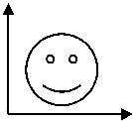
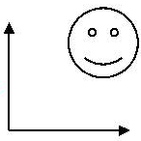
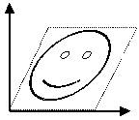
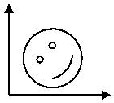
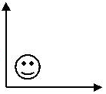
2D Geometrical Transformations
Translate
Shear
Rotate
Scale

Slide 3
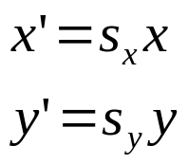
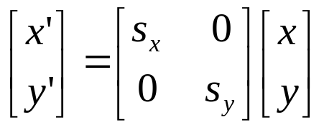
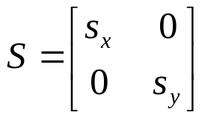
Scaling
Scaling is a linear transformation that enlarges or diminishes objects.
Points can be scaled (stretched) by s_{x} along the x axis and by s_{y} along the y axis into the new points by the multiplication.
We can specify how much bigger or smaller by means of a “scale factor”.
To double the size of an object we use a scale factor of 2, to half the size of an object we use a scale factor of 0.5.
If we define we have P’=S.P

Slide 4
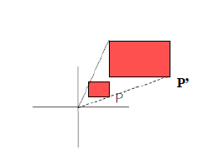
Scaling
If both the scaling factors are same, it is called as uniform scaling.
If the scaling factors are different, it is called as differential scaling.
Scaling actually happens about the origin.
If the figure is somewhere else, there can be a contraction and also a shift.

Slide 5
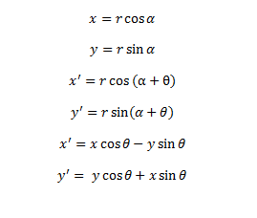
Rotation
Points can be rotated through an angle θ about the origin.
If the rotation is in anti-clock wise direction, it is assumed to be a positive rotation.
P’(x’,y’)
y
P(x,y)
l
y’
θ
α
O
x’
x

Slide 6
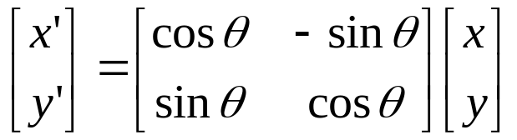
Rotation
That is, P’= R. P

Slide 7
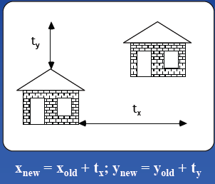
Translation
Moving an object is called a translation.
We translate a point by adding to the x and y coordinates, respectively, the amount the point should be shifted in the x and y directions.
We translate an object by translating each vertex in the object.

Slide 8
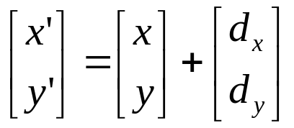
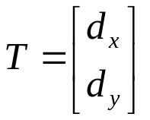
Translation
P(x,y) -> P’(x,y)
x’=x + dx;
y’= y + dy
P’ = P + T
Here, T is the displacement vector and not the transformation matrix.

Slide 9
We need all the transformations in the form of matrix multiplication.
We could do this for all transformations except translation.
Ideally, all transformations should be the same.
Solution: Homogenous coordinates

Slide 10
Homogeneous Coordinates
For a given 2D coordinates (x, y), we introduce a third dimension:
[x, y, 1]
In general, a homogeneous coordinates for a 2D point has the form:
[x, y, W]
Two homogeneous coordinates [x, y, W] and [x’, y’, W’] are said to be of the same (or equivalent) if
x = kx’ eg: [2, 3, 6] = [4, 6, 12]
y = ky’ for some k ≠ 0 where k=2
W = kW’
Therefore any [x, y, W] can be normalised by dividing each element by W:
[x/W, y/W, 1]

Slide 11
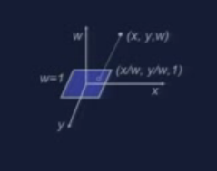
Homogeneous Coordinates

Slide 12
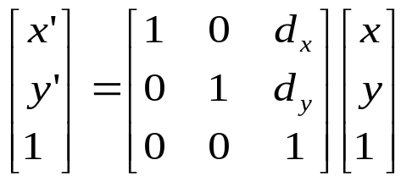

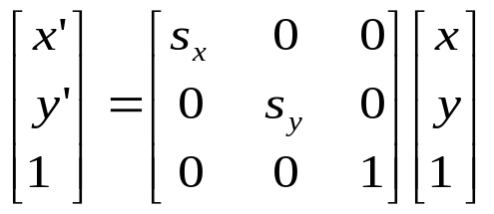

Homogeneous Transformations
Now, redefine the translation by using homogeneous coordinates:
Similarly, we have:
Scaling
Rotation
P’ = S × P
P’ = R × P

Slide 13
IMPORTANT
Here, we represent points by column vectors and applies transformations by left multiplying by the transformation matrix.
We have chosen this approach because it is the standard normally used.
The other notation represents points by row vectors and applies transformations by right multiplying by the transformation matrix.
It is used in much of the computer graphics literature.
To change from one notational style to another, it is necessary to take the transpose of the matrices that appear in any expression.

Slide 14

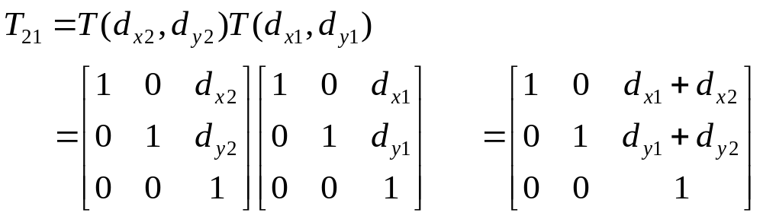
Composition of 2D Transformations
Additivity of successive translations
We want to translate a point P to P’ by T(d_{x1}, d_{y1}) and then to P’’ by another T(d_{x2}, d_{y2})
On the other hand, we can define T₂₁= T(d_{x1}, d_{y1}) T(d_{x2}, d_{y2}) first, then apply T₂₁ to P:

Slide 15
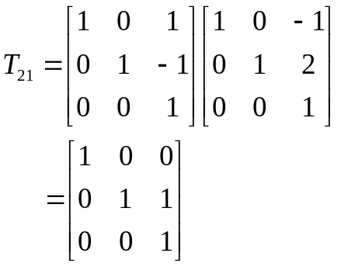
Examples of Composite 2D Transformations
(1,3)
T(-1,2)
T(1,-1)
(2,2)
(2,1)

Slide 16
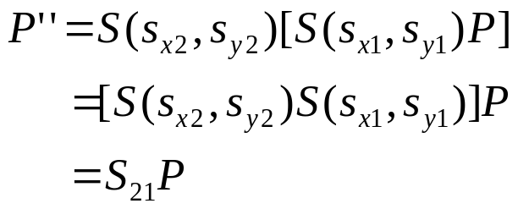
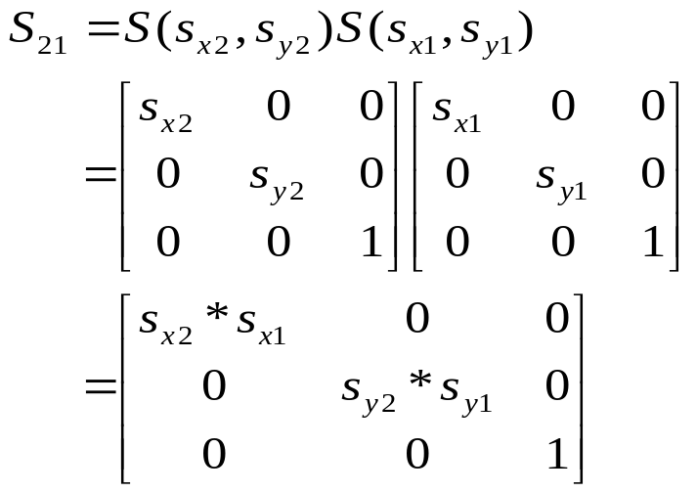
Composition of 2D Transformations (cont.)
Multiplicativity of successive scalings

Slide 17
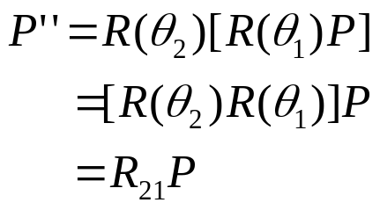
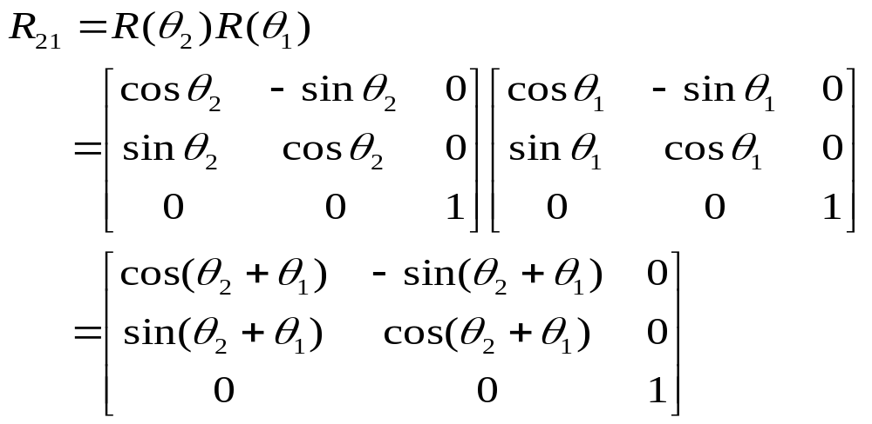
Composition of 2D Transformations (cont.)
3. Additivity of successive rotations

Slide 18
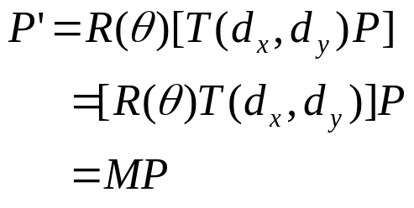

Composition of 2D Transformations (cont.)
4. Different types of elementary transformations discussed above can be concatenated as well.
where

Slide 19
Other Than Point Transformations…
Translate Lines: Translate both endpoints, then join them.
Scale or Rotate Lines: More complex.
For example, consider to rotate an arbitrary line about a point P₁, three steps are needed:
1). Translate such that P₁ is at the origin;
2). Rotate;
3). Translate such that the point at the origin returns to P₁.
P₂(3,3)
P₂
T(-1,-2)
R(θ)
P₂
T(1,2)
P₂(2,1)
P₁
P₁(1,2)
θ
P₁
P₁

Slide 20
Another Example.
Translate
Translate
Rotate
Scale

Slide 21
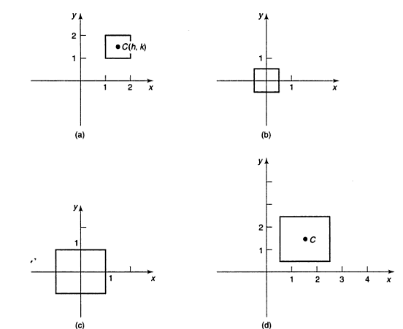
Question
Express as a matrix (Composite Transformation Matrix) the transformation which magnifies an object about its center C(h,k).

Slide 22
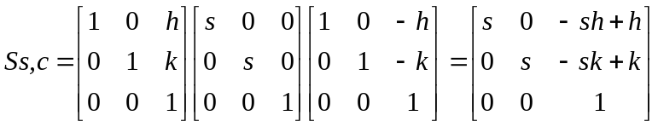
Using the column-vector Notation S_{s,c} =T_{v} . S_{s,s} . T_{v}⁻¹

Slide 23
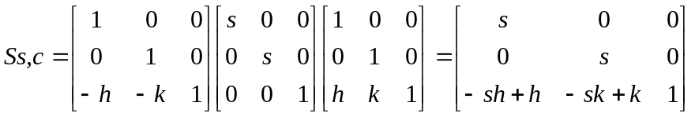
Using the row-vector Notation S_{s,c} =T_{v} . S_{s,s} . T_{v}⁻¹

Slide 24
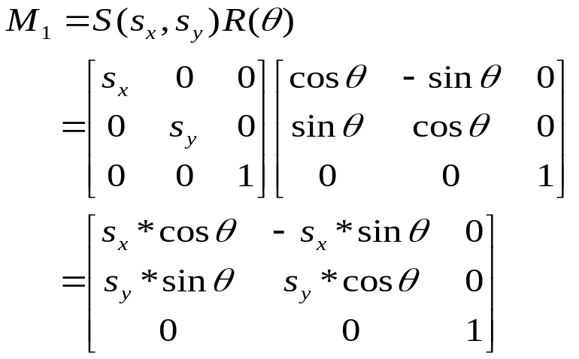
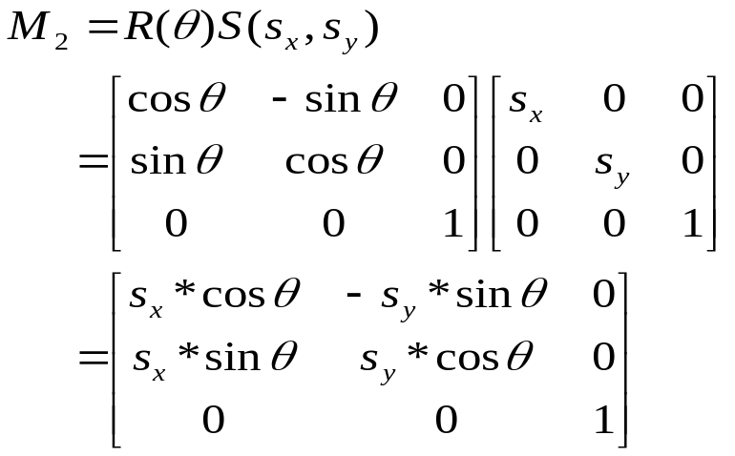
Order Matters!
As we said, the order for composition of 2D geometrical transformations matters, because, in general, matrix multiplication is not commutative. However, it is easy to show that, in the following four cases, commutativity holds:
1). Translation + Translation
2). Scaling + Scaling
3). Rotation + Rotation
4). Scaling (with s_{x} = s_{y}) + Rotation
just to verify case 4:
if s_{x} = s_{y}, M₁ = M₂.

Slide 25
REFLECTION
A reflection is a transformation that produces a mirror image of an object.
The mirror image for a 2D reflection is generated relative to an axis of reflection by rotating the object 180⁰ about the reflection axis.
The axis of reflection can be in the XY plane or perpendicular to the XY plane.
When the reflection axis is a line in the XY plane, the rotation path about this axis is in a plane perpendicular to the XY plane.
When the reflection axis is perpendicular to the XY plane, the rotation path is in the XY plane.

Slide 26
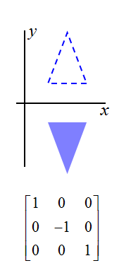
REFLECTION
Reflection about the line y=0, i.e about X-axis:

Slide 27
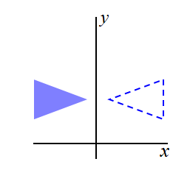
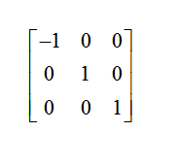
REFLECTION
Reflection about the line x=0, i.e about Y-axis:

Slide 28
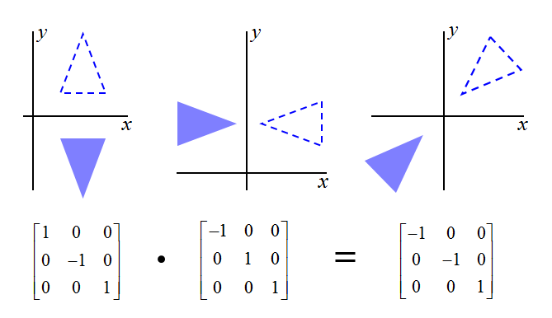
REFLECTION
Reflection relative to the co-ordinate origin: Flip both x and y coordinates of a point by reflecting relative to an axis that is perpendicular to the xy plane and that passes through the coordinate origin.

Slide 29
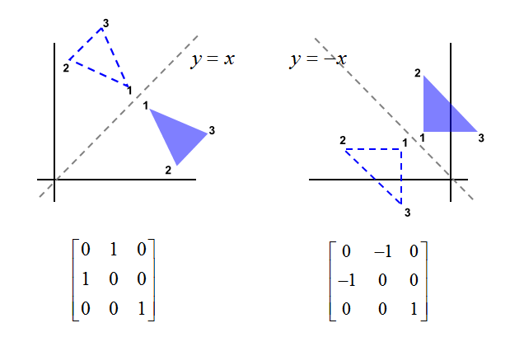
REFLECTION

Slide 30
REFLECTION
Sequence of transformations to produce reflection about the line y=x:
  Clockwise rotation of 45⁰.
  Reflection about the x axis.
  Counter clock wise rotation by 45⁰.

Slide 31
REFLECTION
Sequence of transformations to produce reflection about the line y=-x:
  Clockwise rotation of 45⁰.
  Reflection about the y axis.
  Counter clock wise rotation by 45⁰.

Slide 32
SHEAR
A transformation that distorts the shape of an object such that the transformed shape appears as if the object were composed of internal layers that had been caused to slide over each other is called a shear.
A transformation that slants the shape of an object is called as shearing transformation.
Two Common shearing transformations:
  Shifts x co-ordinate values
  Shifts y co-ordinate values
When shearing is applied in both x and y directions simultaneously, it is termed as simultaneous shearing.

Slide 33
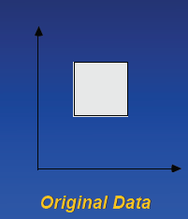
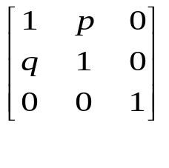
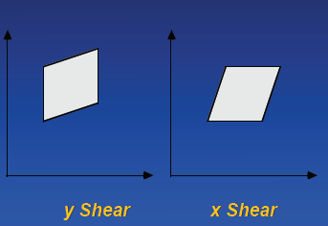
SHEAR
Simultaneous Shear:

Slide 34
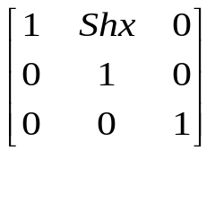
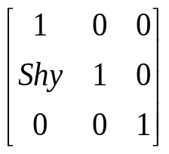
SHEAR
X Shear:
  This preserves y co-ordinate values, but changes the x values which causes vertical lines to tilt right or left.
Y Shear:
  This preserves x coordinates, but changes the y values which causes horizontal values to transform into lines which slope up or down.

Slide 35
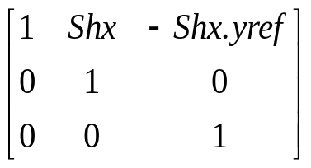
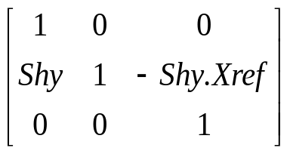
SHEAR
X Shear with y reference line:
Y Shear with x reference line:

Slide 36
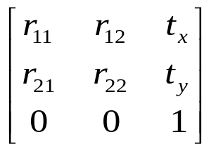
Rigid-Body vs. Affine Transformations
A transformation matrix of the form
where the upper 2×2 sub-matrix is orthogonal, preserves angles and lengths. Such transforms are called rigid-body transformations, because the body or object being transformed is not distorted in any way. An arbitrary sequence of rotation and translation matrices creates a matrix of this form.
The product of an arbitrary sequence of rotation, translations, and scale matrices will cause an affine transformation, which have the property of preserving parallelism of lines, but not of lengths and angles.

Slide 37
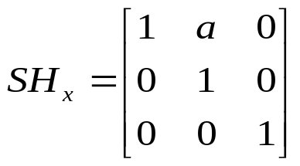
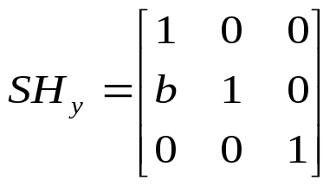
Rigid-Body vs. Affine Transformations (cont.)
Rigid- body
Transformation
Affine
Transformation
Unit cube
45º
Scale in x, not in y
Shear transformation is also affine.
Shear in the x direction
Shear in the y direction

Slide 38
3D TRANSFORMATIONS

Slide 39
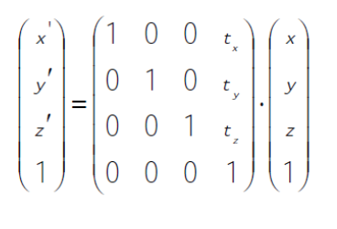
TRANSLATION

Slide 40
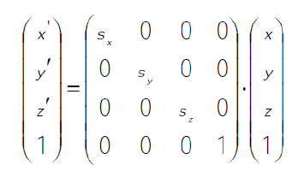
SCALING

Slide 41
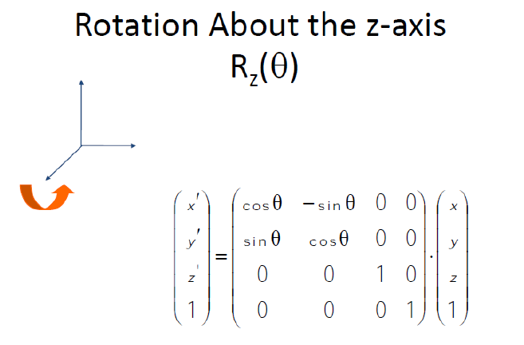
ROTATION

Slide 42
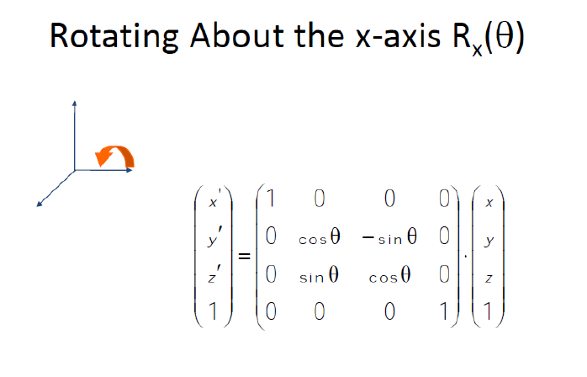
ROTATION

Slide 43
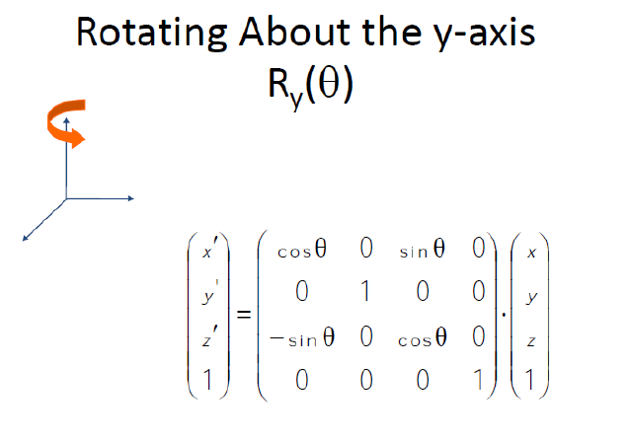
ROTATION

Slide 44
Thank You…

